Slide 1
United Airlines Departure Delays at Newark (EWR):
A Comparison of 2018 vs 2023
Brandon Fernandes
Data Science Programming Final
Professor Binowski
Fall 2025

Slide 2
Introduction
Examine how United Airlines’ departure delays at Newark Liberty International Airport (EWR) changed between 2018 and 2023

Slide 3
Methodology
www.transtats.bts.gov
Bureau of Transportation Statistics
Incorporates Python in Jupyter Notebooks with Pandas and Matplotlib libraries

Slide 4
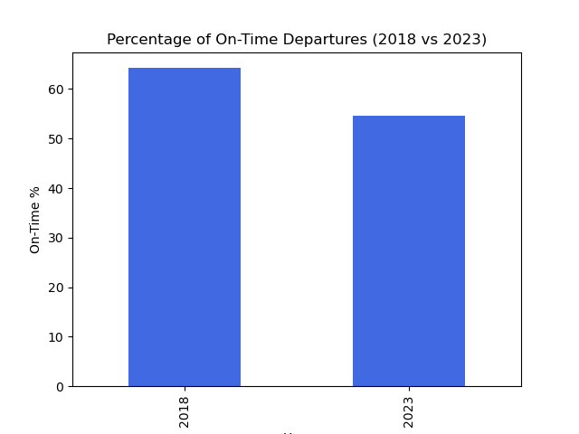
Percentage of On-Time Departures
What percentage of United flights departed on time in 2018 vs 2023?

Slide 5
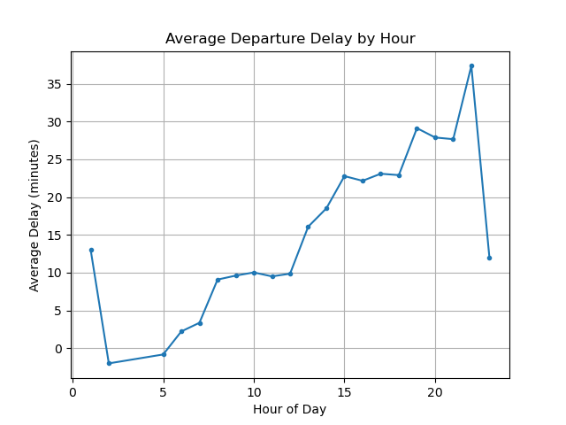
Average Delay by Time of Day
Are certain times of day more prone to delays for United flights departing EWR?

Slide 6
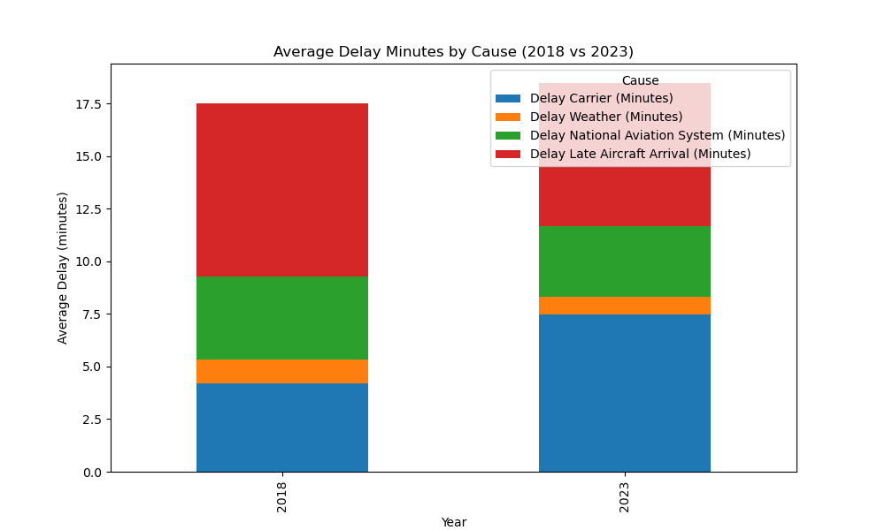
Which delay causes (weather, carrier, NAS, late aircraft) were most significant in each year?
Delay Causes by Year

Slide 7
Future Work
Examine weather conditions
Compare United to other airlines

Slide 8
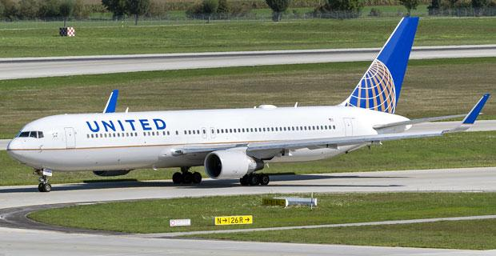
Thank you!
Questions?
December 17, 2025

